Slide 1
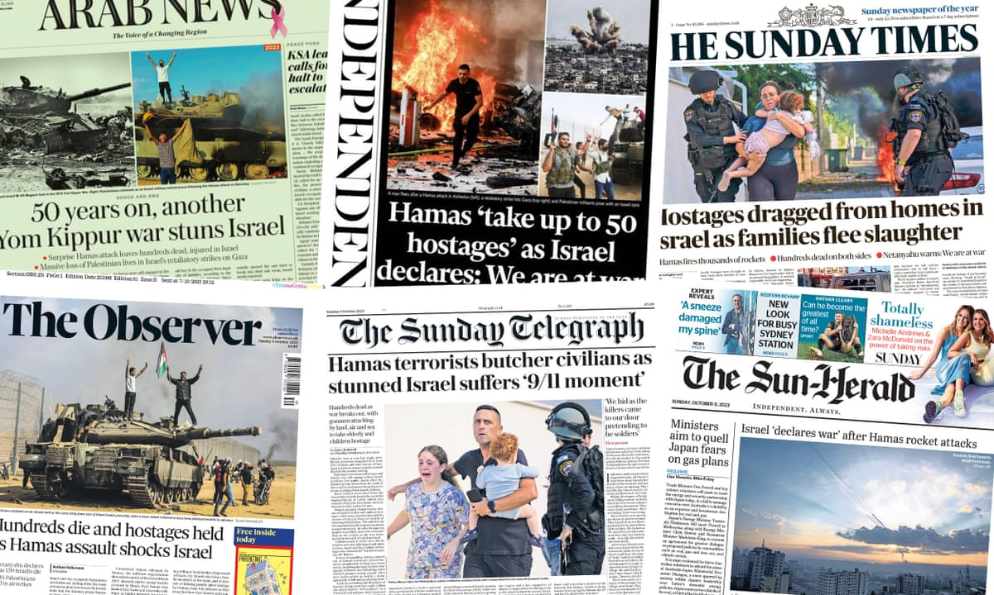
CIS600 :Principles of Social Media and Data Mining Sentiment Analysis on Israel-Palestine Conflict using Reddit Data

Slide 2
Team members
Vikas Papana SUID: 227772035
Prashant Sagar Kottakota SUID: 969978673
Sri Chaitanya Chivatam SUID: 290797110
Oviyah Sridhar SUID: 216584031
Aswarth Kanuri SUID: 240092396

Slide 3
Introduction
What ? Sentiment analysis of Israel-Palestine war Data
Why ? One of the most recent highlighted incident
Data Source Extracted from Reddit app

Slide 4
Workflow of the project
Reddit API
Data Extraction
Data Preprocessing
Sentiment Intensity Analyser
Analysis
Conclusion

Slide 5
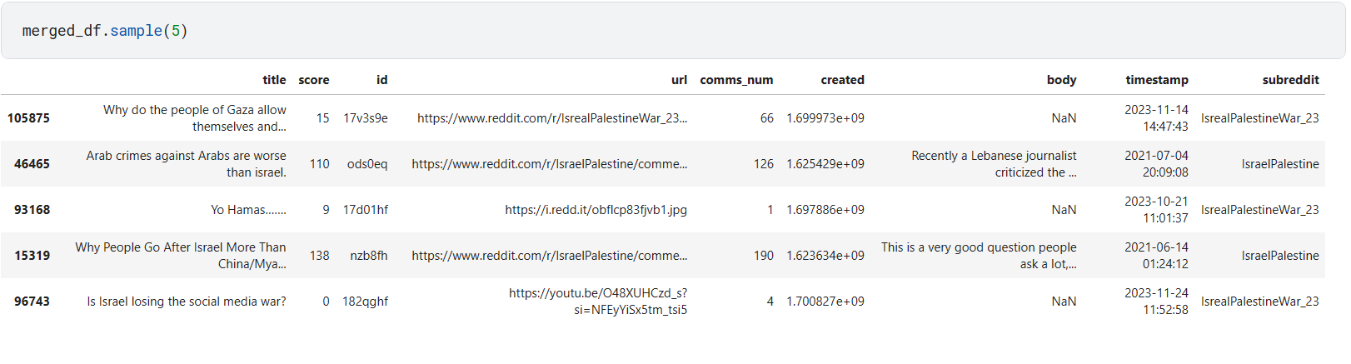
Data Collection - Reddit API

Slide 6
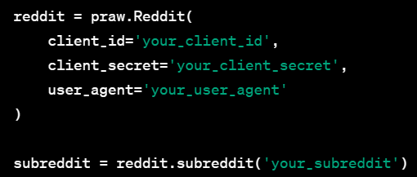
Data Collection - PRAW
PRAW (Python Reddit API Wrapper) is a Python library that serves as a wrapper for the Reddit API
With PRAW, developers can use Python to interact with Reddit programmatically without dealing with the low-level details of the API.
It provides a way for external applications, scripts, or services to access and manipulate Reddit data, such as posts, comments, user information, and subreddit details.

Slide 7
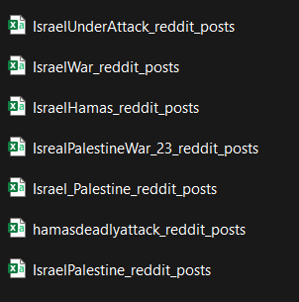
Steps in Data Extraction from Reddit
Importing Libraries like PRAW, pandas
Setting Up Reddit API Credentials
Accessing Subreddit - “Israel Palestine”, “IsraelPalestineWar_23” etc ..
Setting up parameters such as limit and number of requests
Fetching posts in chunks
Collecting post information in the form of python objects
Create a dataframe
Convert the dataframe into csv
Merge data into dataframe before data pre processing

Slide 8
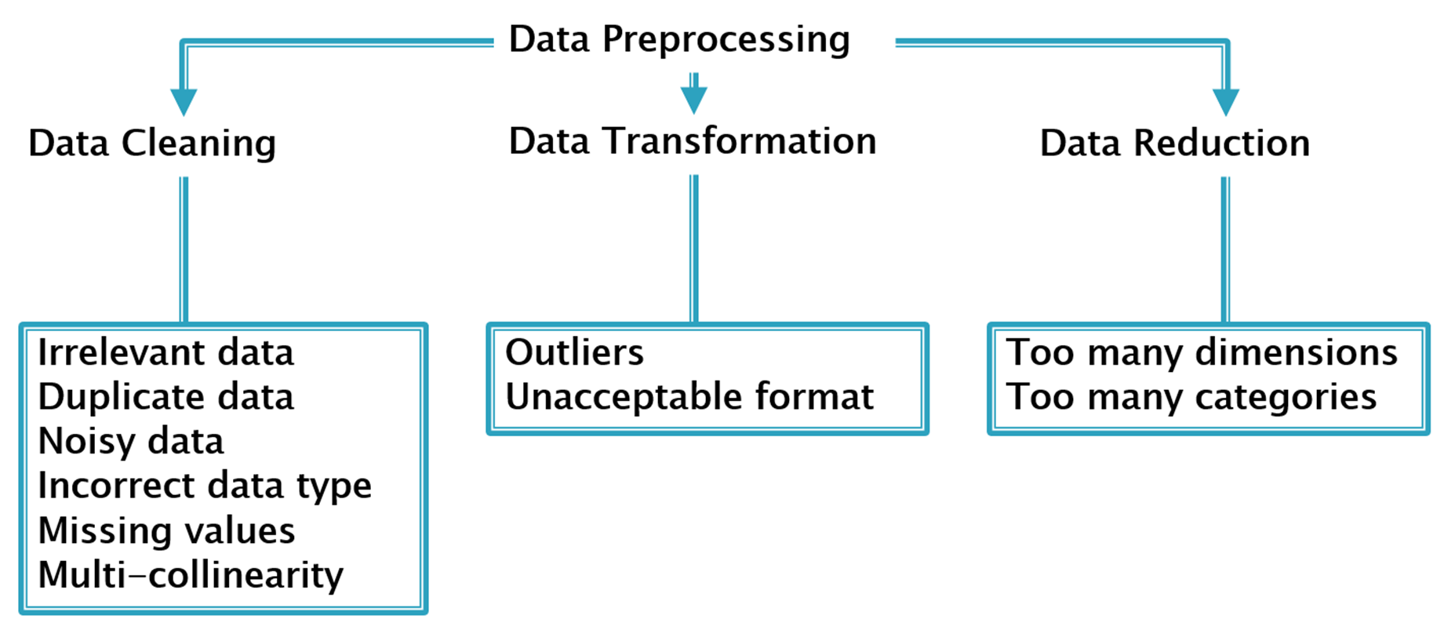
Data Preprocessing

Slide 9
More Details on Data Pre processing
Copy relevant columns
Drop NaN values
Convert text to lower to ensure consistency
Remove @handlers
Remove URLs
Remove Special Characters
Remove Single Characters
Substitute Multiple Spaces with Single space
Convert timestamp to a datetime format

Slide 10
Sentiment Analysis
“VADER” model for Sentiment Analysis
Sentiment scores using VADER
Classification based on compound score

Slide 11
Feature Engineering
Naïve Feature extraction
Named Entity Extraction
Time Based Sentiment Analysis
Text decomposition analysis

Slide 12
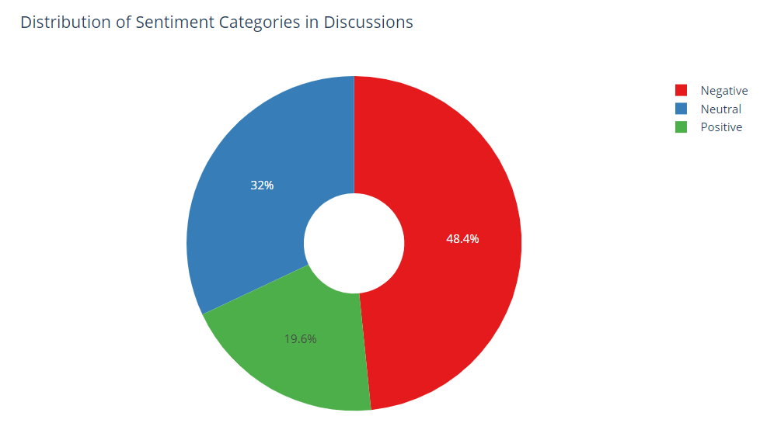
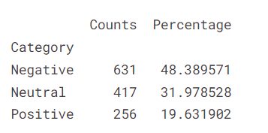
Results - Analysis of Data

Slide 13
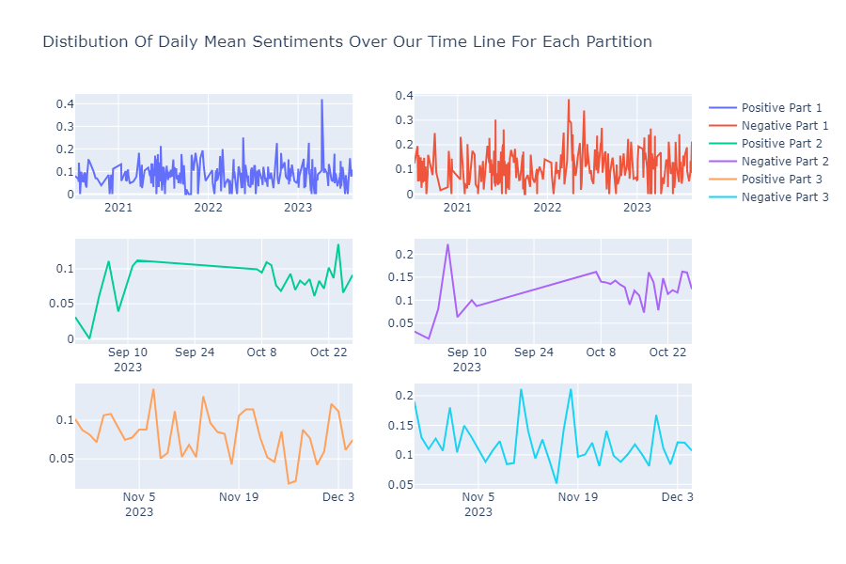

Slide 14
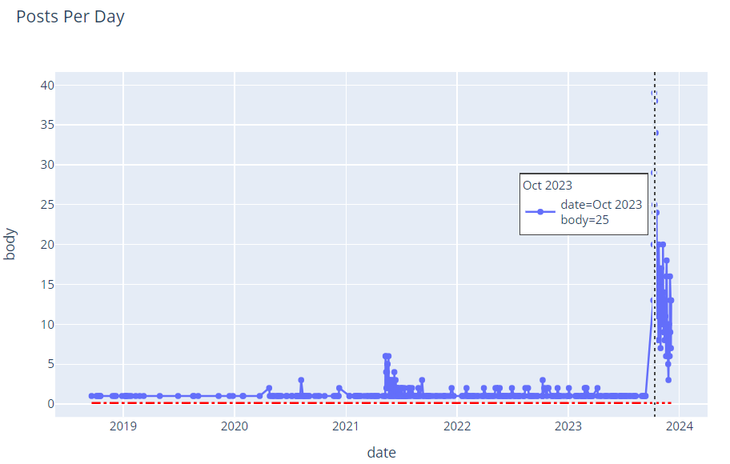

Slide 15
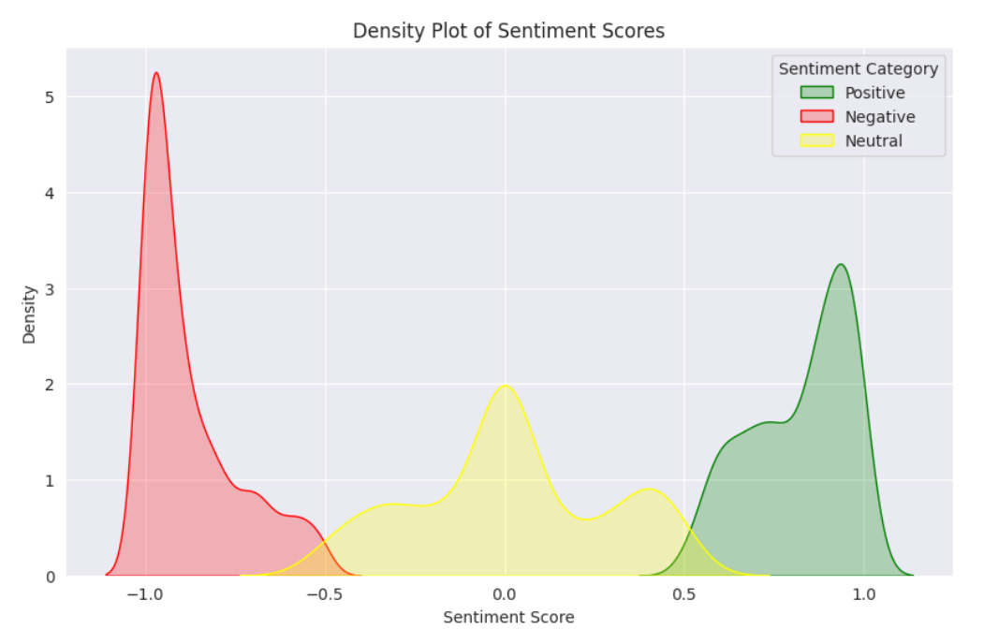

Slide 16
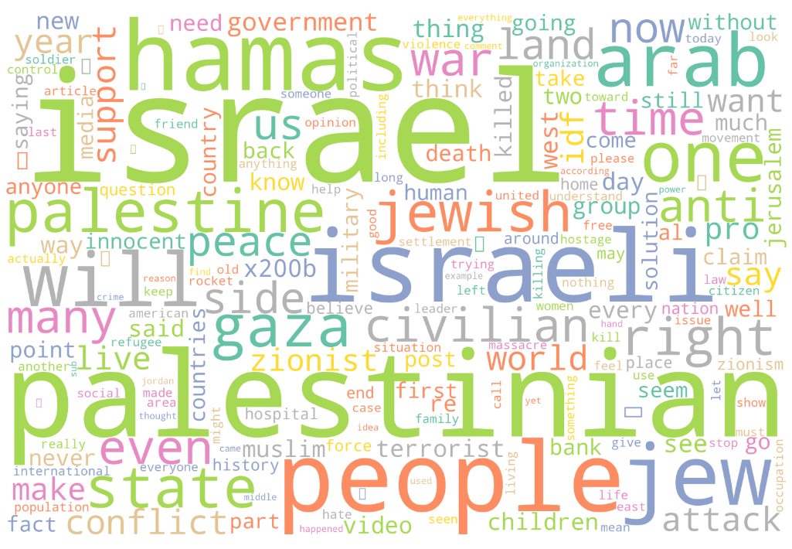
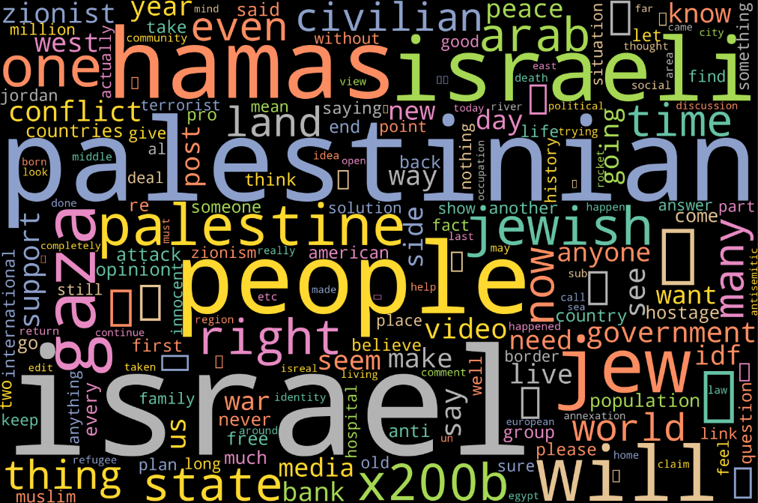
Word Clouds
Compound Data
Neutral Data

Slide 17
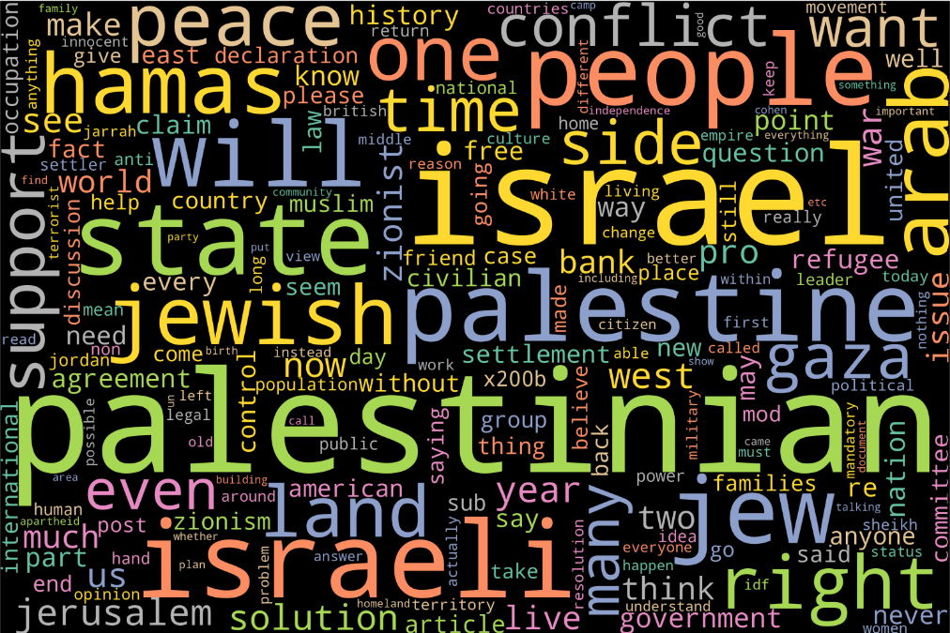
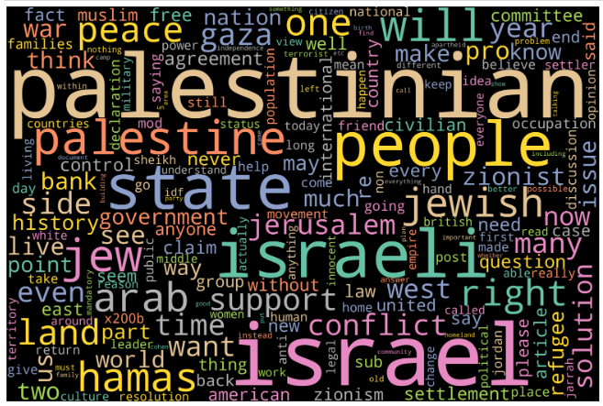
Positive Data
Negative Data

Slide 18
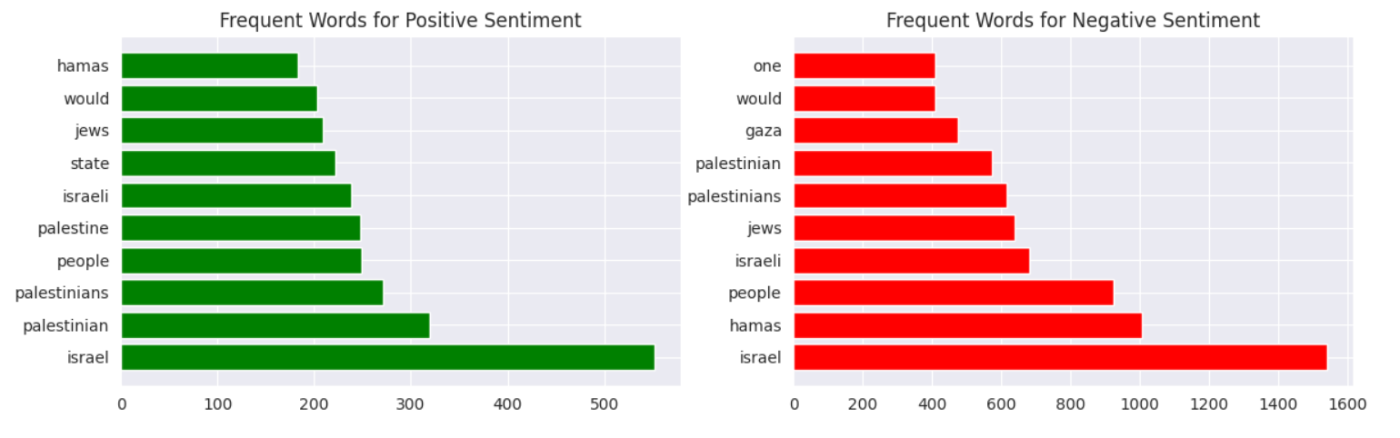

Slide 19
Conclusion
In simpler terms, our project looked at people's feelings and thoughts about the Israel-Palestine conflict using Reddit posts. We found out what most people were saying, what topics kept coming up, and how these discussions changed over time. By understanding different users' perspectives, we got a better idea of what shapes these conversations.
Our study holds significance for decision-makers, organizations, academics, and groups striving for positive change as it provides them with valuable insights for making informed decisions. We prioritized responsible data handling and ensured people's privacy throughout our research.

Slide 20
THANK YOU

